Slide 1
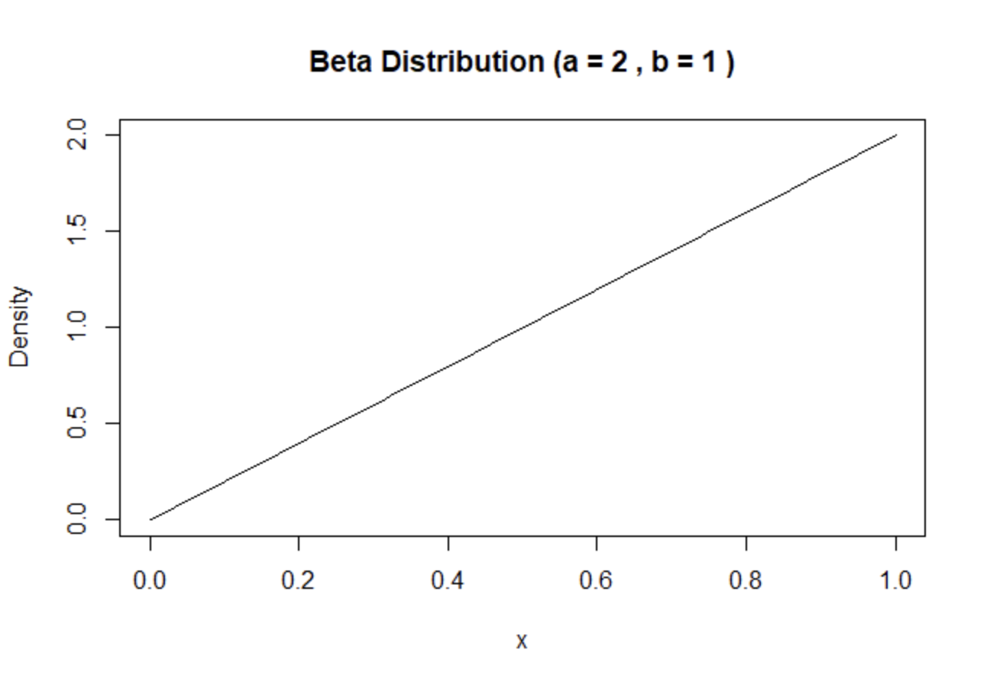
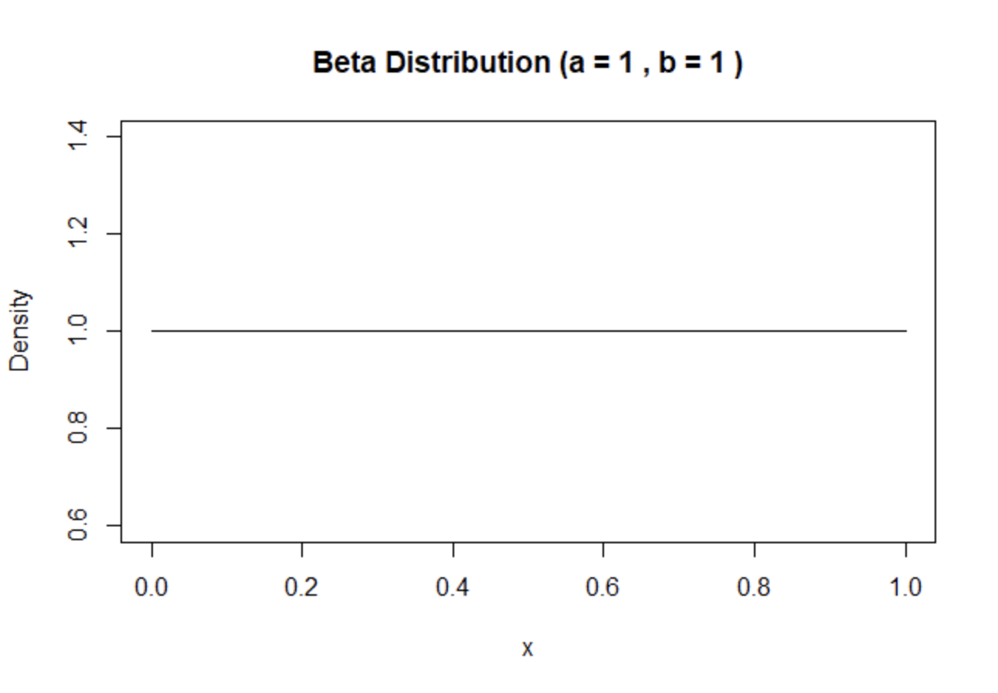
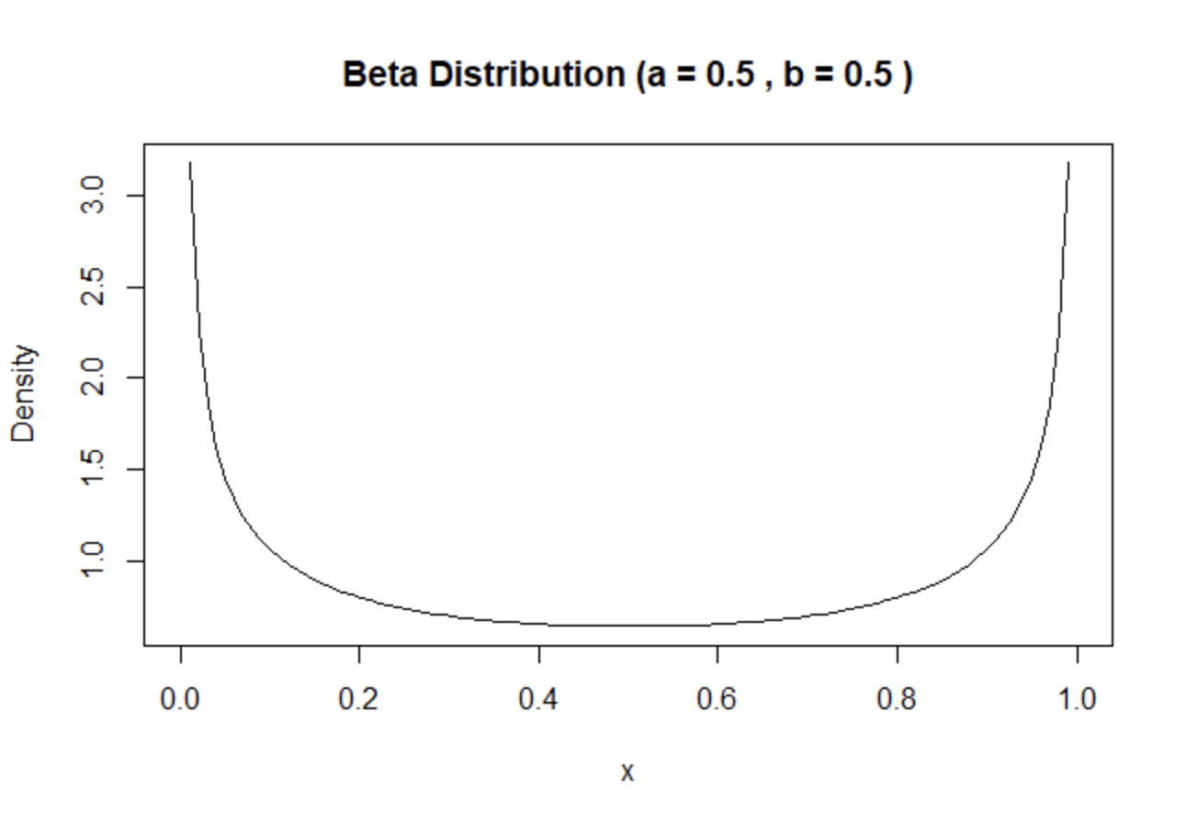
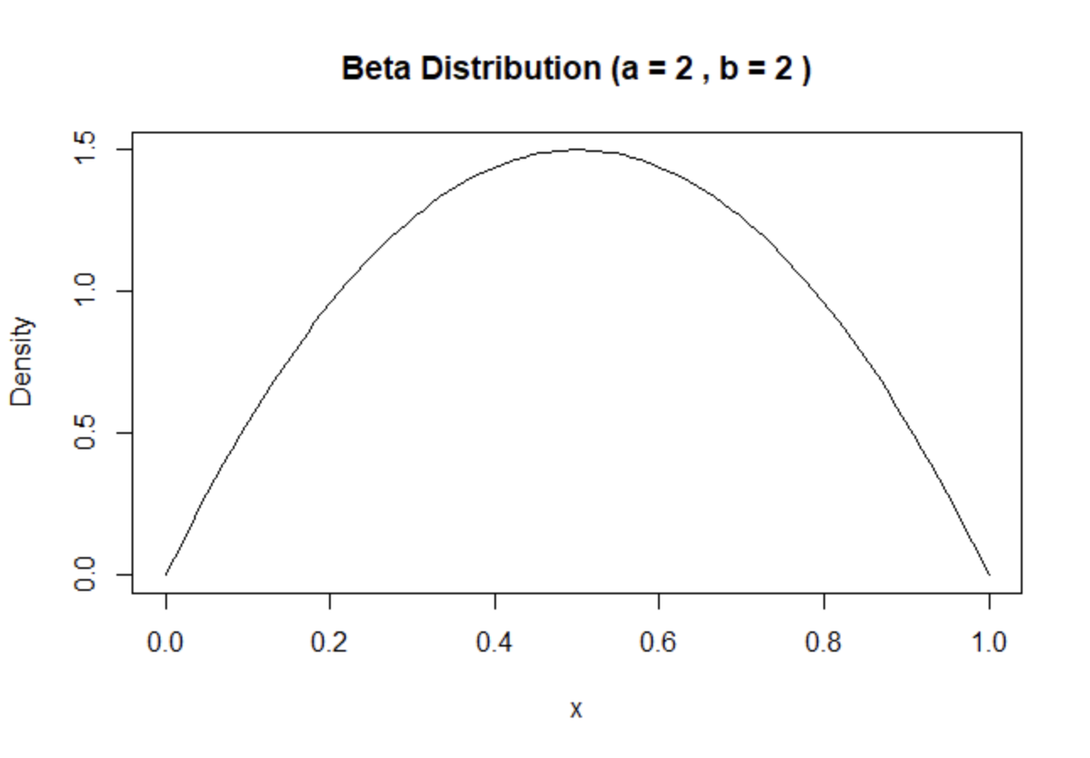
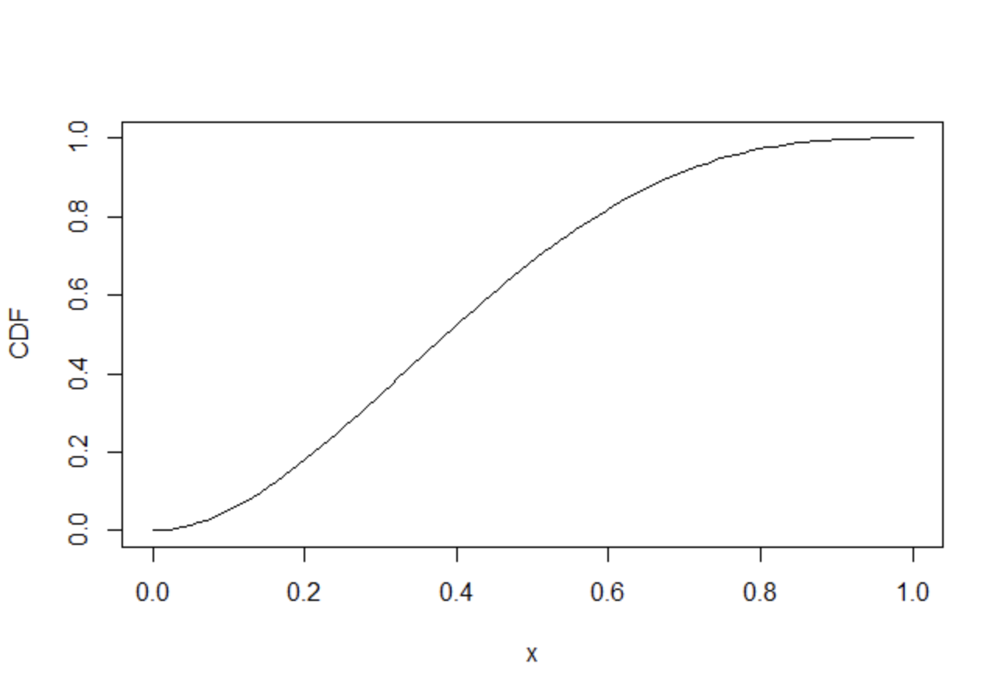
Some Applications and End of The Story
Story of Beta(a,b):
B
PDF:
f(x) = cx^a-1(1-x)^b-1; a>0,b>0,0<x<1
CDF:
B(x; a,b)/B(a,b)
MGF:
M(t) = 1 + ∑(k=1 to ∞)[∏(r=0 to k−1)a+r/(a+b+r)]t^k/k!
Mean:
a/(a+b)
Normalizing Constant
C = ⌐(a+b)/⌐(a)⌐(b)
Not just a distribution, but a family of them
Generalization of Uniform distribution
Conjugate prior to Binomial
Doesn’t take one shape, flexible, so useful modelling tool
Often used as prior for a parameter in (0,1)
The Sunrise Example
Order Statistics
Wavelate Analytics
Population Genetics (genetic distance between two population)
E
Beta Distribution
T
A
Harsh Mittal
So far, only dist we know by name that is both bounded & cont is unif like unif(0,1).
What if we want to generalize like Normal goes from -∞ to ∞ and Expo goes like 0 to ∞?
What if we want that is still bounded between 0 to 1 but not just flat?
By far that most closely follow these criteria is Beta!
Kanav Meena
ThankYou!!
By:
Harsh Mittal
Kanav Meena
Pranav Jha
Pranav Jha

